Slide 1
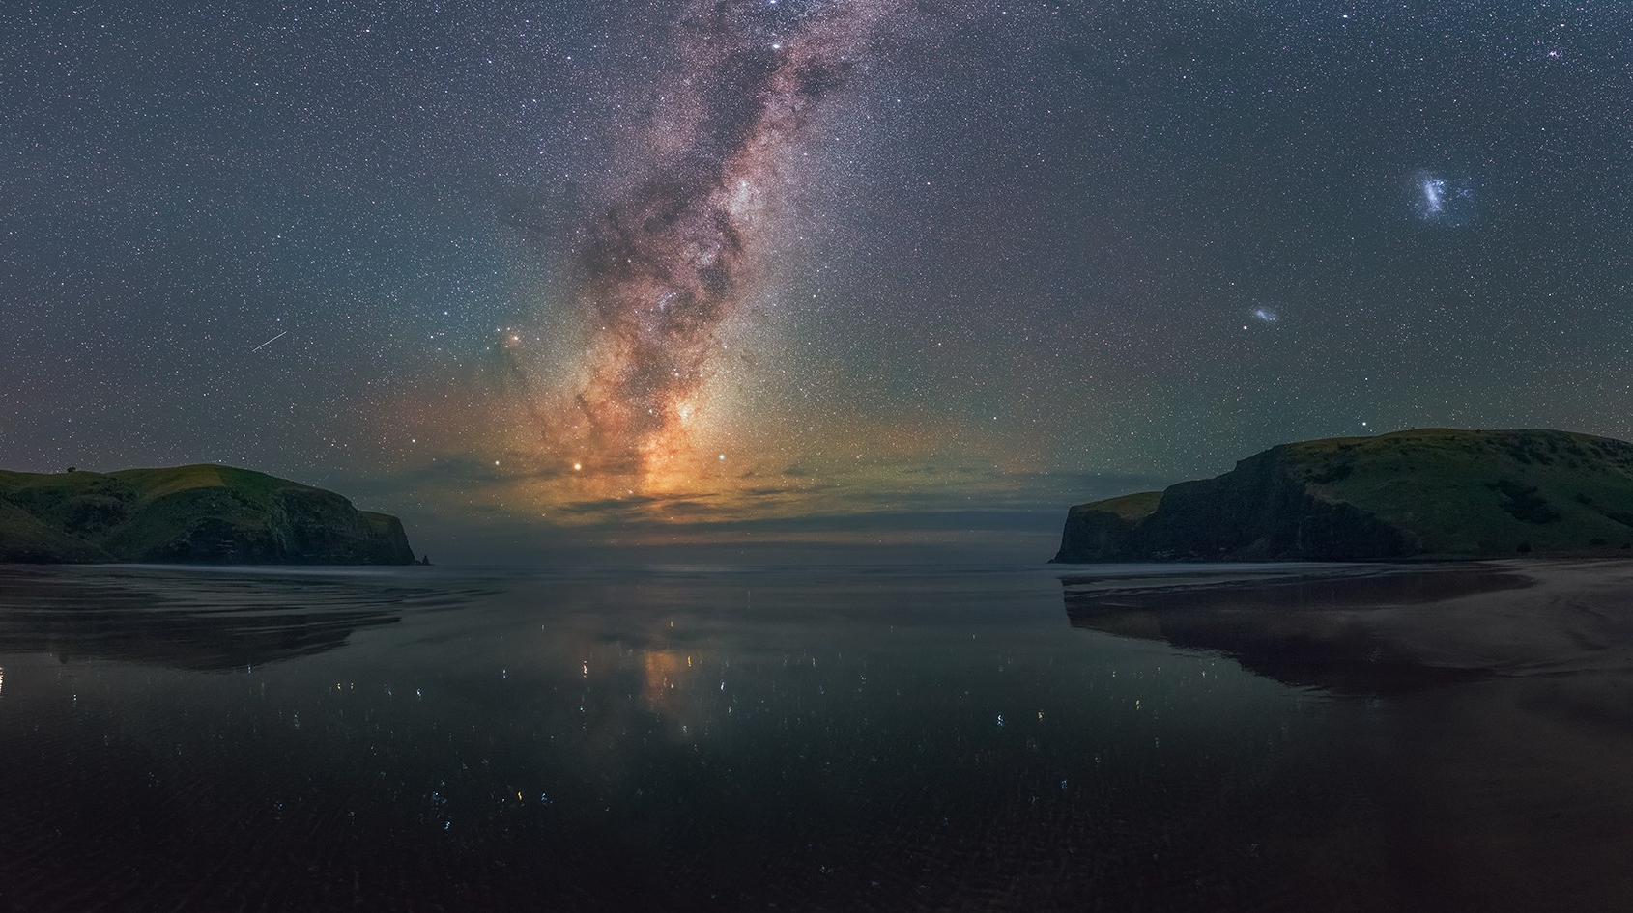
Measuring the Night Sky

Slide 2
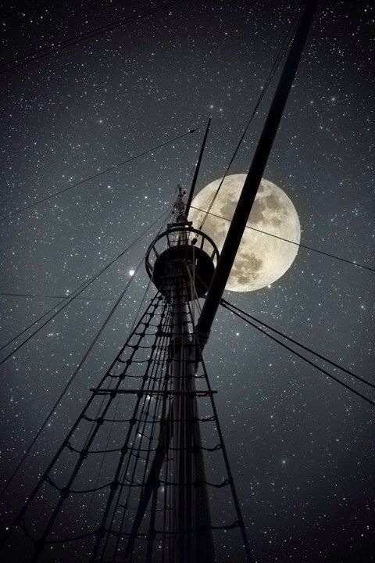
How did people know their location on Earth before GPS?

Slide 3
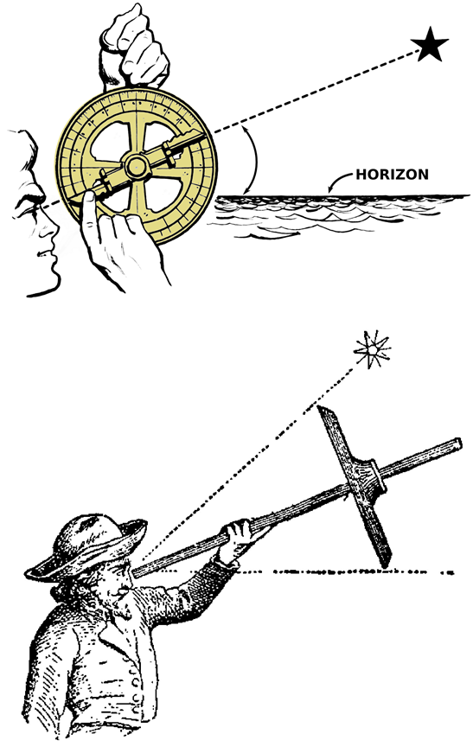
How did people know their location on Earth before GPS?
Latitude
Polaris
Sun @ Noon
Longitude
Time Measurements
Polynesians
Stars

Slide 4
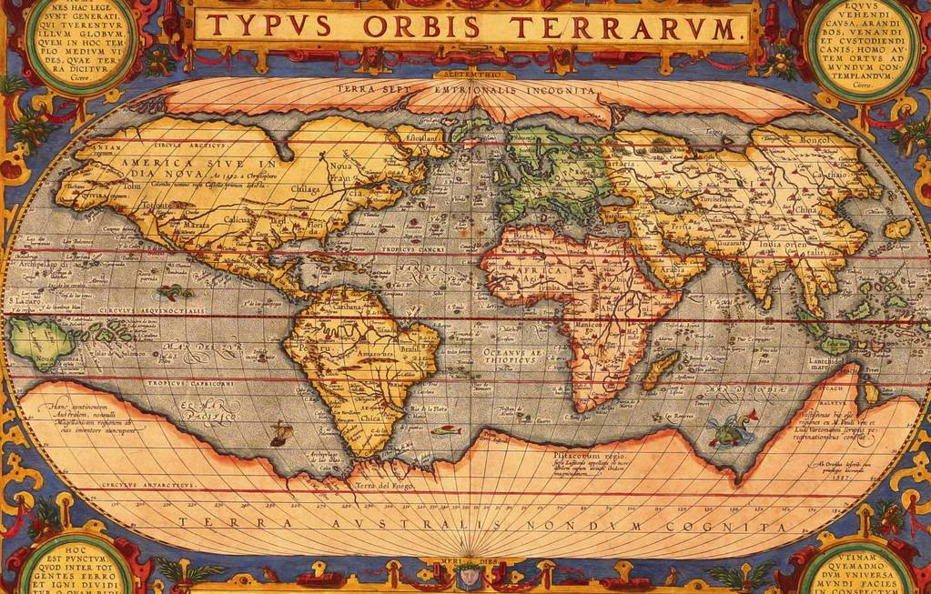
How did people know their location on Earth before GPS?
Latitude
Polaris
Sun @ Noon
Longitude
Time Measurements
Polynesians
Stars

Slide 5
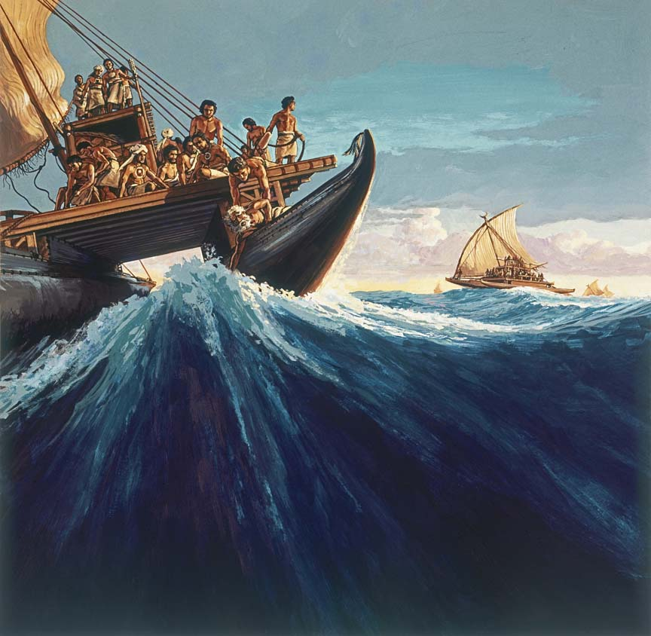
How did people know their location on Earth before GPS?
Latitude
Polaris
Sun @ Noon
Longitude
Time Measurements
Polynesians
Stars

Slide 6
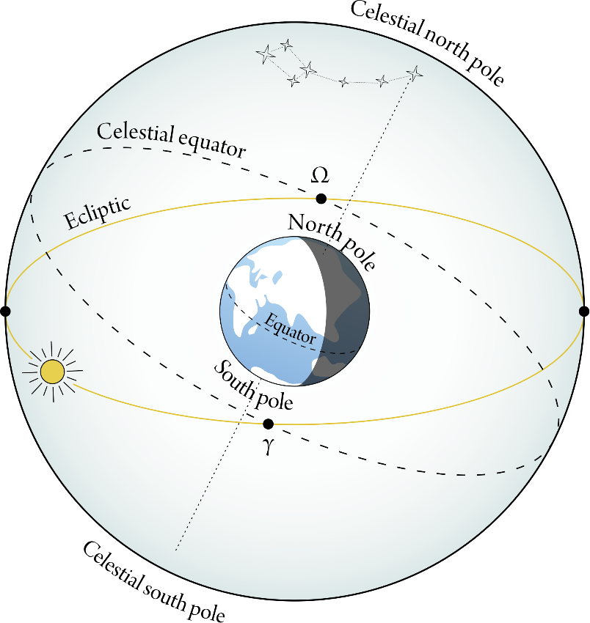
The imaginary line in the sky which defines zero declination coincides with
the plane of the Earth's orbit
the plane of the Earth's equator
the ecliptic
the plane of the Solar System
the galactic plane

Slide 7
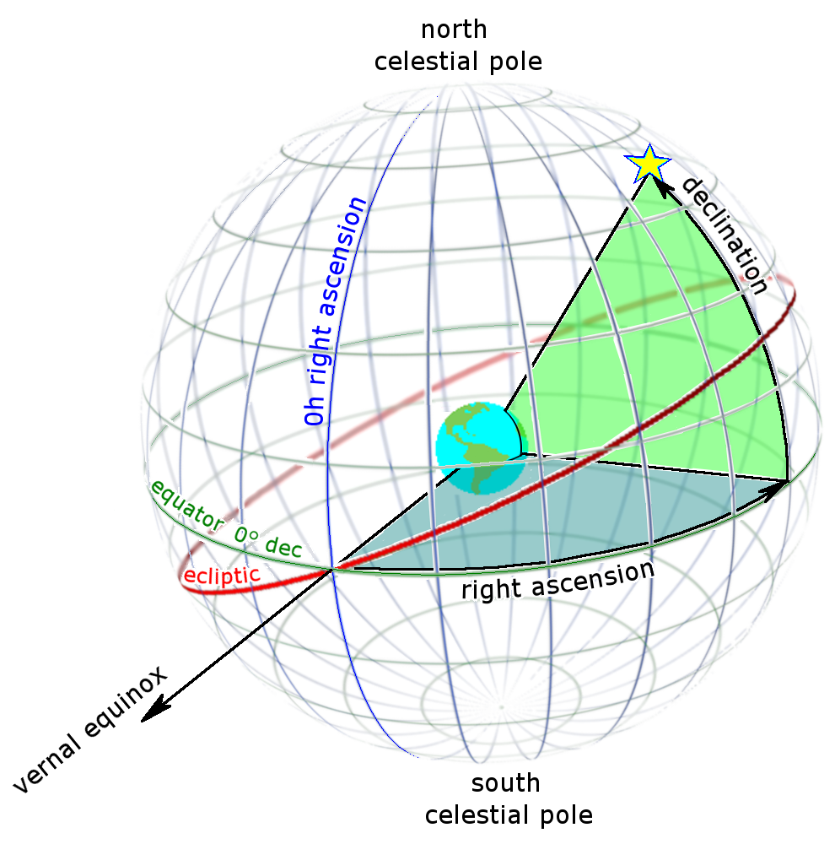
The imaginary line in the sky which defines zero declination coincides with
the plane of the Earth's equator

Slide 8
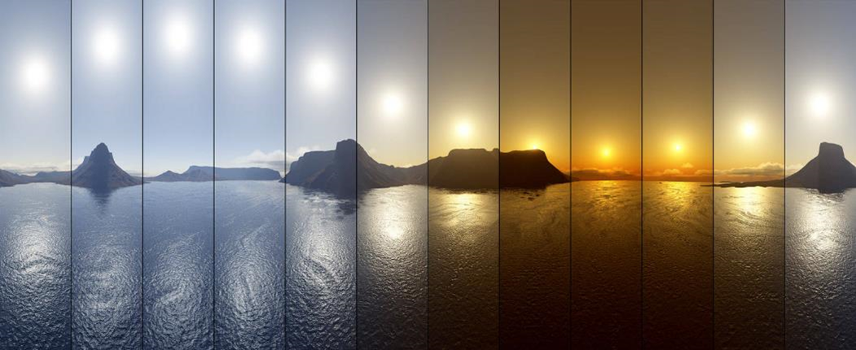
At noon on the Summer Solstice, the Sun’s right ascension is roughly
6 hours
12 hours
45 degrees
23 degrees
12,000,000 feet

Slide 9
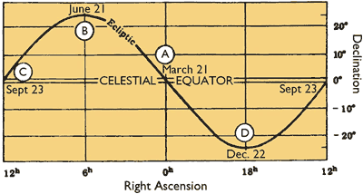
At noon on the Summer Solstice, the Sun’s right ascension is roughly
6 hours

Slide 10
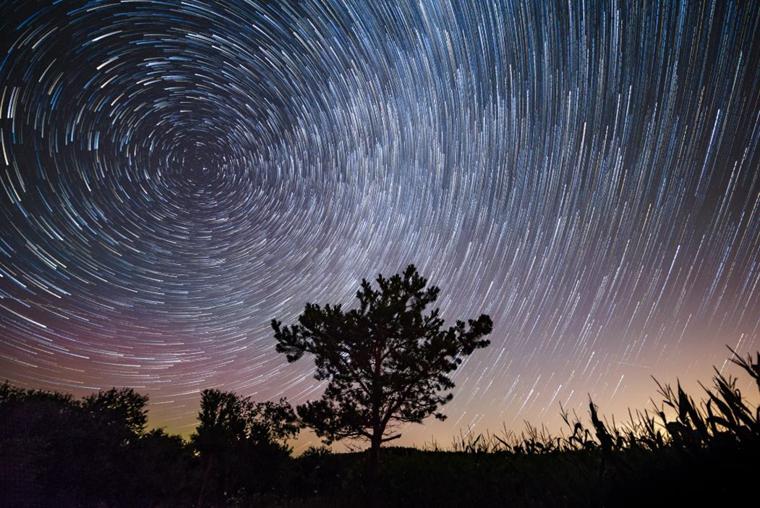
The North pole of Earth’s rotation axis currently points closest to the star
Spica
Vega
Zeta Reticuli
Polaris
Thuban

Slide 11
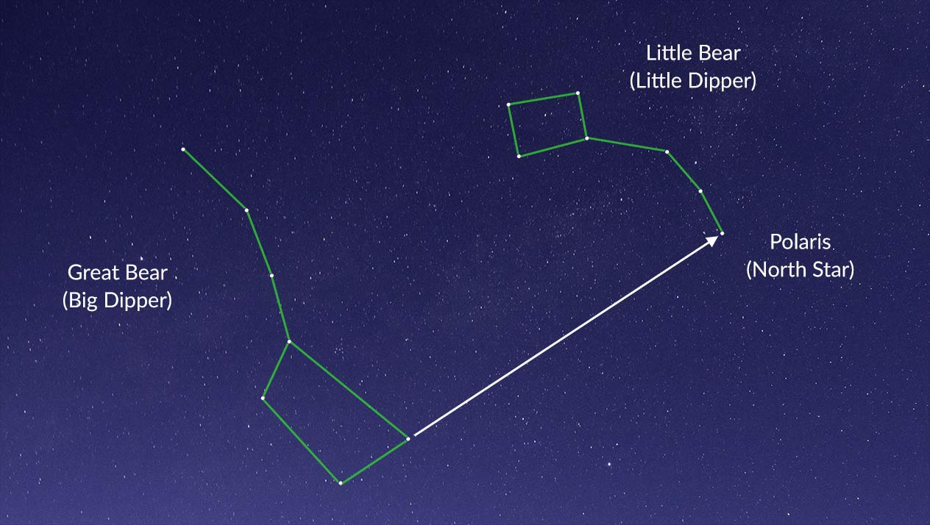
The North pole of Earth’s rotation axis currently points closest to the star
Polaris

Slide 12
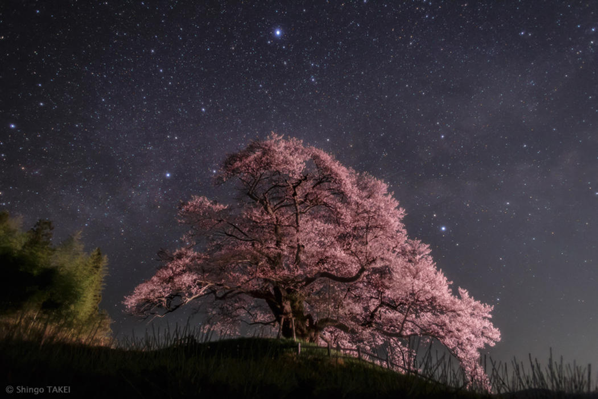
Which of the following is not a star in the Summer Triangle?
Aquila
Vega
Deneb
Altair

Slide 13
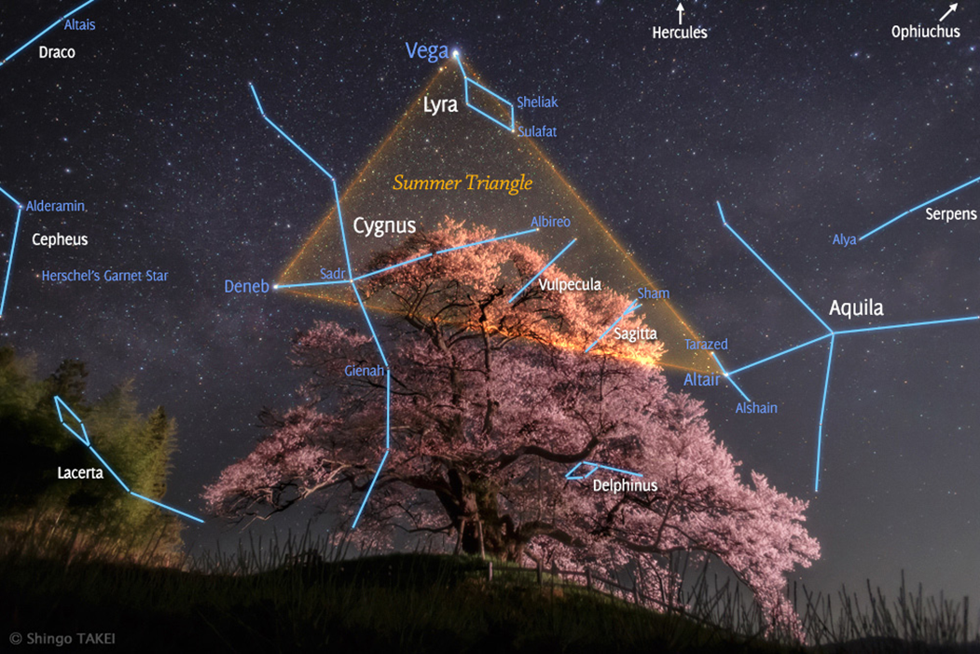
Which of the following is not a star in the Summer Triangle?
Aquila

Slide 14
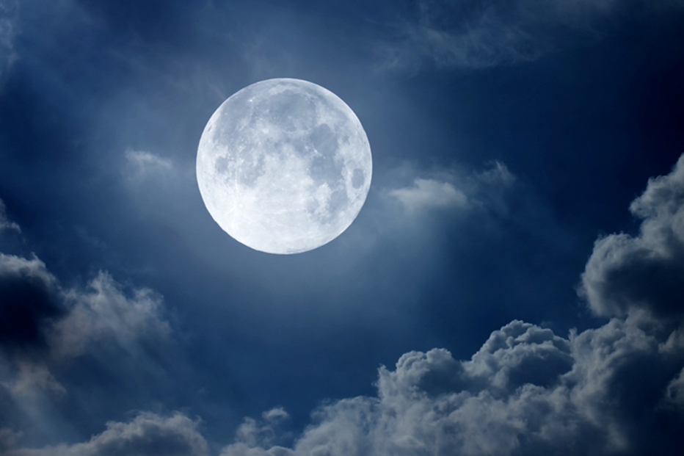
Compared to an observer in Iowa, an observer in New Zealand would see an upside-down moon.
True
False

Slide 15
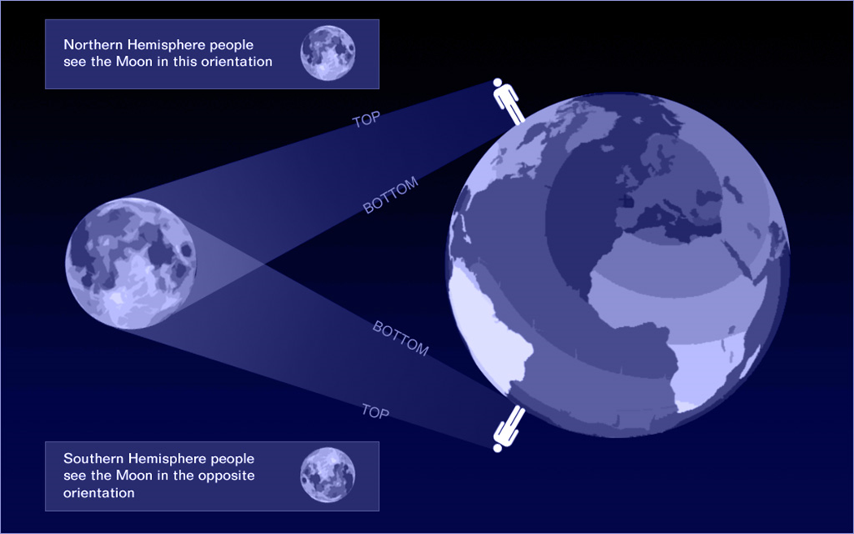
Compared to an observer in Iowa, an observer in New Zealand would see an upside-down moon.
True

Slide 16
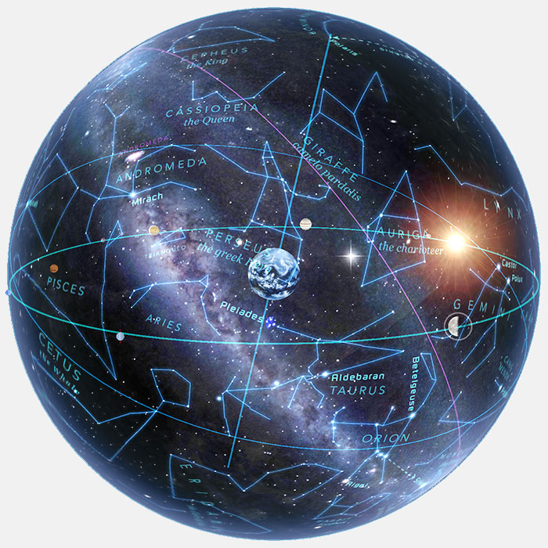
Celestial Sphere
An imaginary sphere centered around Earth on which all celestial objects are considered to lie

Slide 17
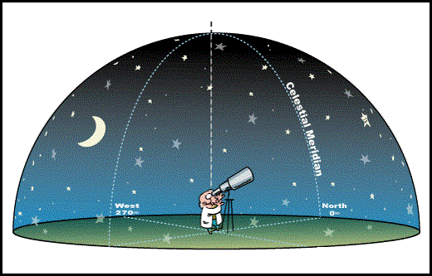
Local Celestial Sphere
An imaginary sphere centered around an observer on which all celestial objects are considered to lie.

Slide 18
Definitions
Celestial Equator
Celestial Poles
Earth’s Rotation Axis
The projection of Earth’s equator onto the celestial sphere
The projection of Earth’s poles onto the celestial sphere
A straight line around which the celestial sphere rotates
Equinox
Solstice
The time at which the sun crosses the celestial equator
The time at which the sun reaches its highest or lowest point in the sky at noon
Ecliptic
The apparent path of the Sun on the celestial sphere

Slide 19
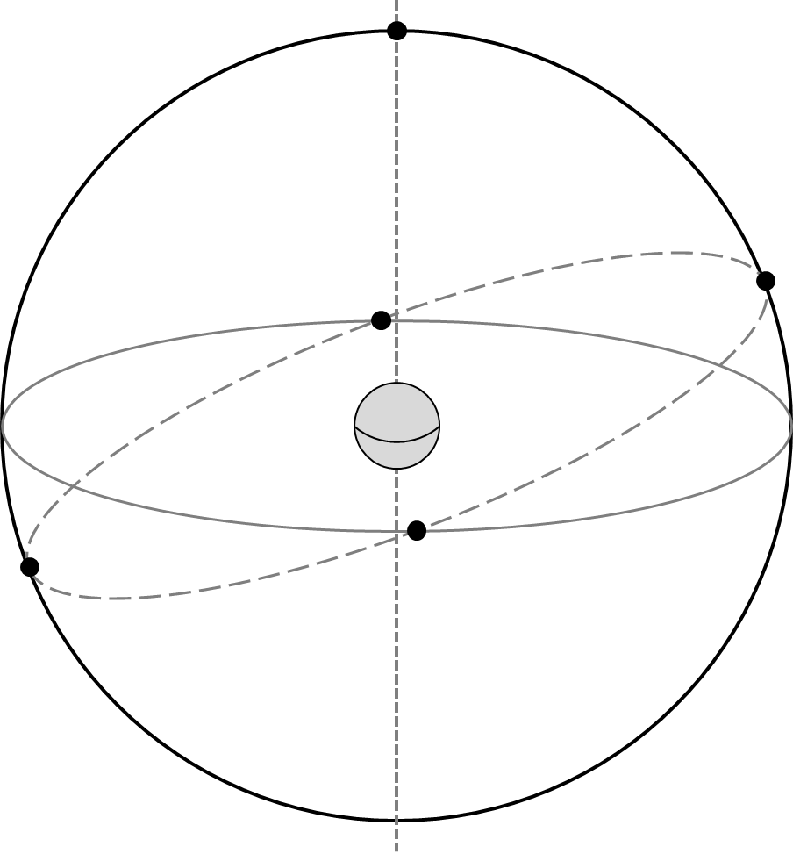
Celestial Equator
The projection of Earth’s equator onto the celestial sphere
Earth’s
Equator
Celestial
Equator

Slide 20
North and South Celestial Poles
NCP
The point on the celestial sphere directly above either of the earth's geographic poles…
Earth’s
Equator
Celestial
Equator
SCP

Slide 21
North and South Celestial Poles
NCP
Earth’s
Rotation Axis
The point on the celestial sphere directly above either of the earth's geographic poles…
…around which the stars and planets appear to rotate during the course of the night.
Earth’s
Equator
Celestial
Equator
SCP

Slide 22
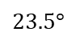
Ecliptic
NCP
Earth’s
Rotation Axis
The apparent path of the sun on the celestial sphere.
Earth’s
Equator
$$23.5°$$
Celestial
Equator
Ecliptic
SCP

Slide 23
NCP
Earth’s
Rotation Axis
Earth’s
Equator
$$23.5°$$
Celestial
Equator
Ecliptic
SCP

Slide 24
NCP
Earth’s
Rotation Axis
Earth’s
Equator
$$23.5°$$
Celestial
Equator
Ecliptic
SCP

Slide 25
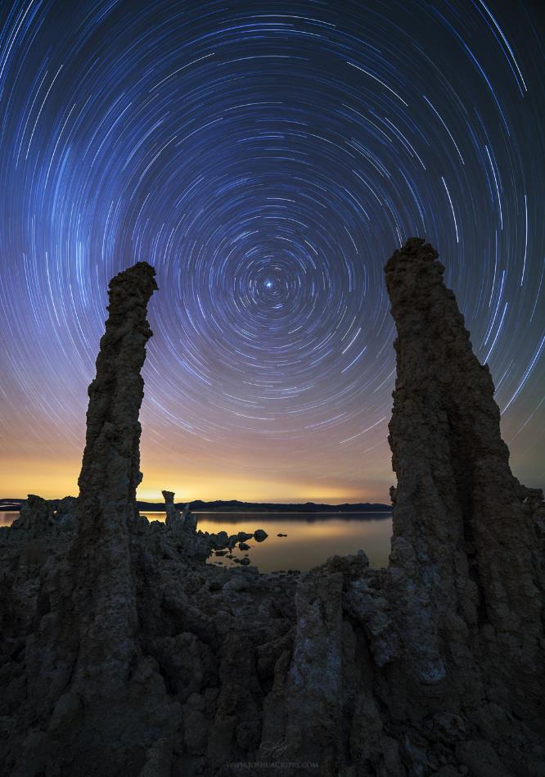
NCP
Polaris
Earth’s
Rotation Axis
Earth’s
Equator
$$23.5°$$
Celestial
Equator
Ecliptic
SCP

Slide 26
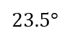
NCP, Polaris
Earth’s
Rotation Axis
Earth’s
Equator
$$23.5°$$
Celestial
Equator
Ecliptic
SCP

Slide 27
NCP, Polaris
Earth’s
Rotation Axis
Summer
Solstice
Earth’s
Equator
$$23.5°$$
Winter
Solstice
Celestial
Equator
Ecliptic
SCP

Slide 28
NCP, Polaris
Earth’s
Rotation Axis
Summer
Solstice
Autumnal Equinox
Earth’s
Equator
Vernal Equinox
$$23.5°$$
Winter
Solstice
Celestial
Equator
Ecliptic
SCP

Slide 29
Local Celestial Sphere
An imaginary sphere centered around an observer on which all celestial objects are considered to lie.

Slide 30
Definitions
Zenith
Meridian
The point on the celestial sphere directly above an observer
A great circle on the celestial sphere that passes through the celestial poles and an observer’s zenith
Azimuth
Horizon
Angle around the horizon, from North (0º) increasing to the East, through 360º
The line at which the earth's surface and the sky appear to meet

Slide 31
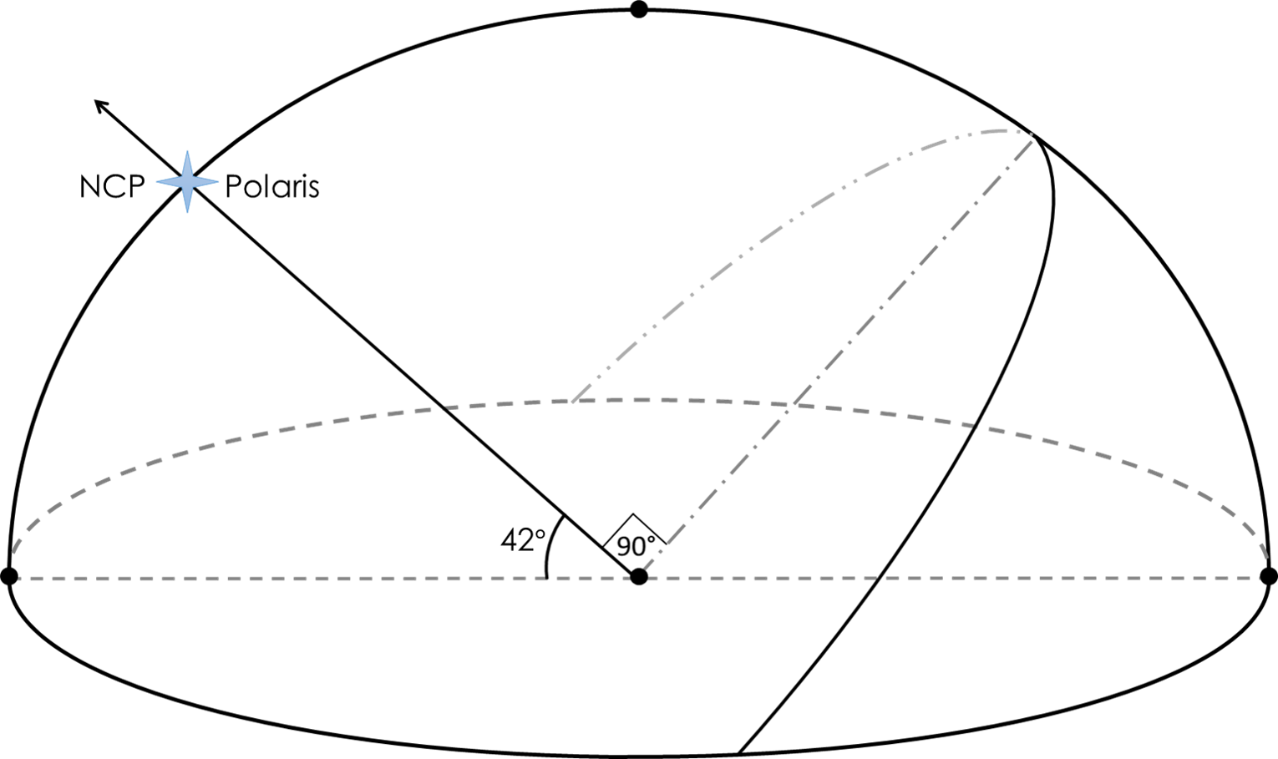
Zenith
Zenith
The point on the
celestial sphere directly
above an observer

Slide 32
Meridian
Zenith
A great circle on
the celestial sphere
that passes through
the NCP, the SCP,
and an observer’s zenith

Slide 33
Meridian
Meridian
Zenith
A great circle on
the celestial sphere
that passes through
the NCP, the SCP,
and an observer’s zenith

Slide 34
Horizon
Meridian
Zenith
The line at which the
earth's surface and the
sky appear to meet
Horizon

Slide 35
Cardinal Directions
Meridian
Zenith
The four main points
on the compass:
north, south, east, west
E
N
Horizon
S
W

Slide 36
Azimuth Angle
Meridian
Zenith
Angle around the horizon,
from North increasing
to the East
E
N
Horizon
S
W

Slide 37
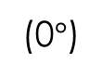
Azimuth Angle
Meridian
Zenith
Angle around the horizon,
from North increasing
to the East
E
N
Horizon
S
(0$°$)
W

Slide 38
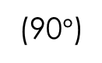
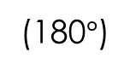
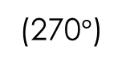
Azimuth Angle
Meridian
Zenith
Angle around the horizon,
from North increasing
to the East
(90$°$)
E
N
Horizon
S
(0$°$)
(180$°$)
W
(270$°$)

Slide 39
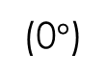
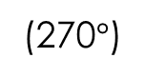
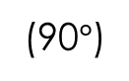
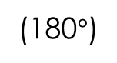
Meridian
Zenith
Celestial
Equator
E
(90$°$)
N
Horizon
S
(0$°$)
(180$°$)
W
(270$°$)

Slide 40
Meridian
Zenith
Sun @noon on V.E.
Celestial
Equator
E
(90$°$)
N
Horizon
S
(0$°$)
(180$°$)
W
(270$°$)

Slide 41
Meridian
Zenith
Sun @noon on S.S. (+23.5º)
Celestial
Equator
E
(90$°$)
N
Horizon
S
(0$°$)
(180$°$)
W
(270$°$)

Slide 42
Meridian
Zenith
Sun @noon on
W.S. (-23.5º)
Celestial
Equator
E
(90$°$)
N
Horizon
S
(0$°$)
(180$°$)
W
(270$°$)

Slide 43
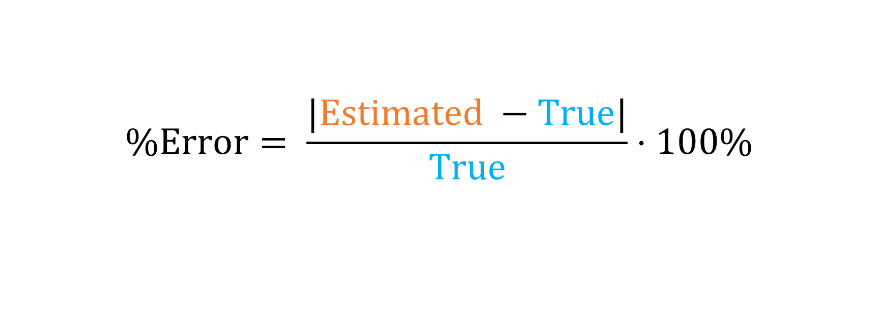
Percent Error Formula
$$\%Error= \frac{|Estimated −True|}{True}⋅100\%$$

Slide 44
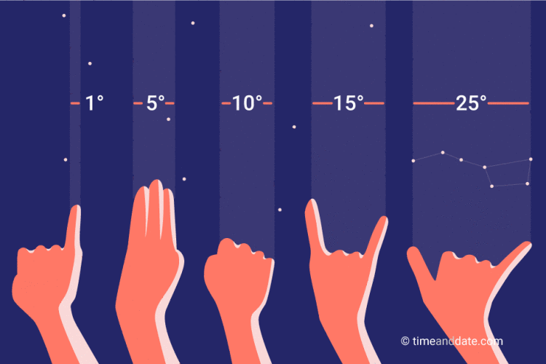

Slide 45
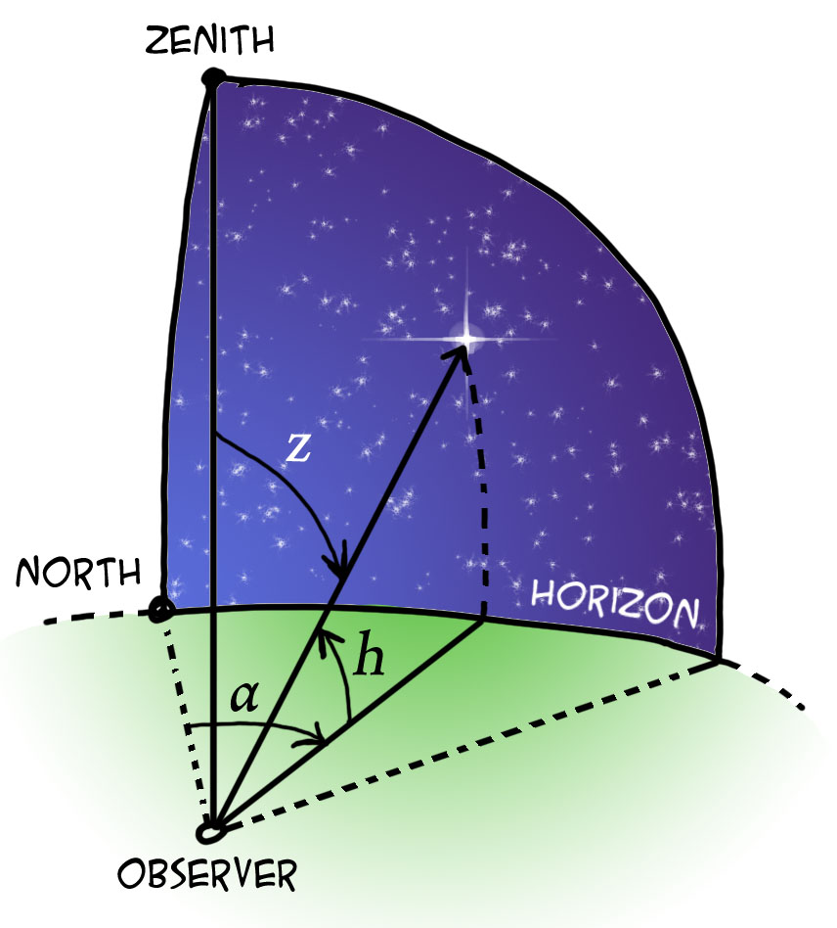
Azimuth & Altitude
Altitude
Angle between horizon and object
Azimuth
Angle around the horizon, from North increasing to the East
(N = 0º, E=90º, S=180º, W=270º)

